Slide 1


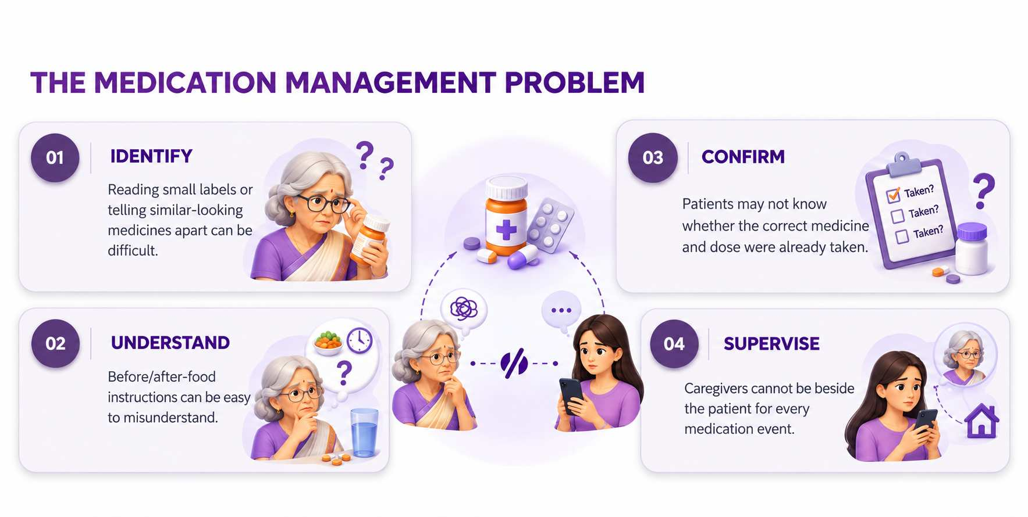
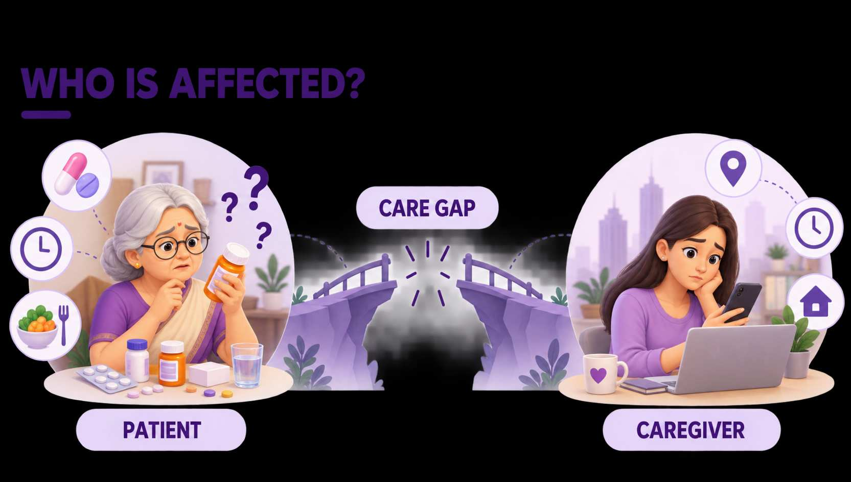

Domain and Problem Statement
DOMAIN:
HEALTHCARE & WELLNESS
Problem:
Elderly and low-literacy patients , children often struggle to manage medicines safely and independently.
2

Slide 2
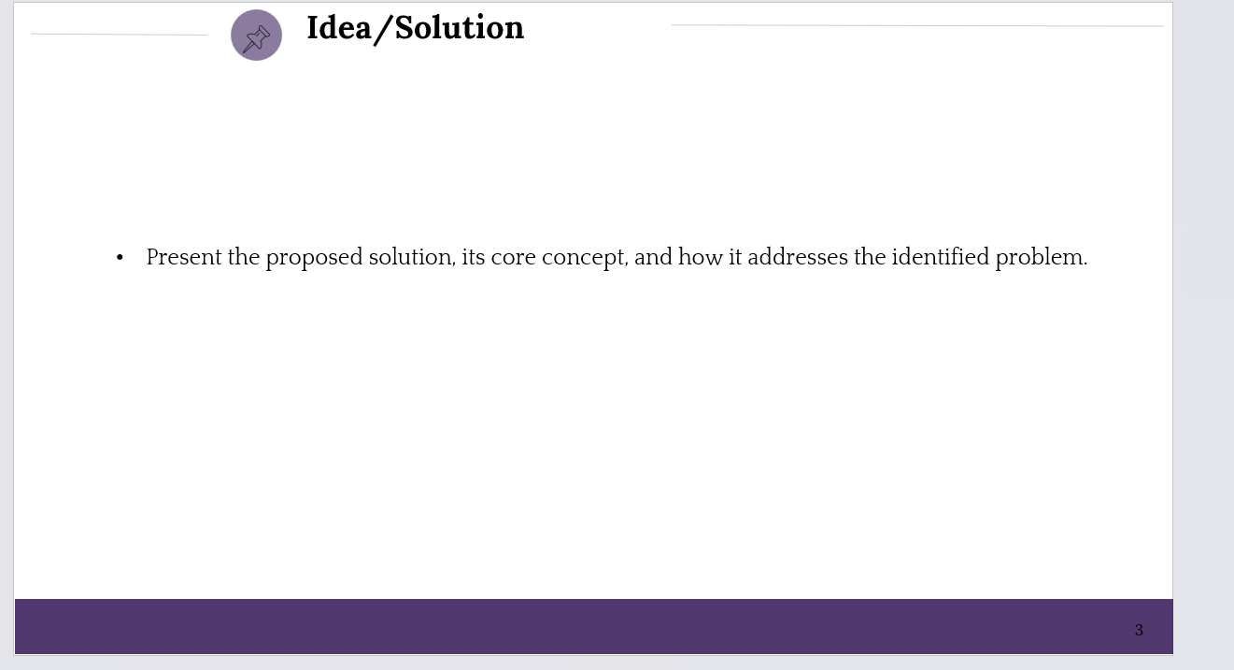

MedSathi is a voice-first AI companion that guides, verifies, and records every step of a patient’s medication routine.
A caregiver-configured AI companion that guides the patient through the COMPLETE medication event.
From reminder to verified care — MedSathi guides every medication event
01
1
CAREGIVER
2
MEDSATHI
PATIENT
4
CAREGIVER
3
Sets medicine,
dosage, timing &
reference images
Understands
context using
voice + AI
Shows medicine /
tablet → receives
simple guidance
Dose logged →
status & alerts
when needed
THE SHIFT
Reminder → Guided action → Verified medicine → Confirmed dose → Caregiver visibility
“A reminder tells. MedSathi guides.”
3

Slide 3
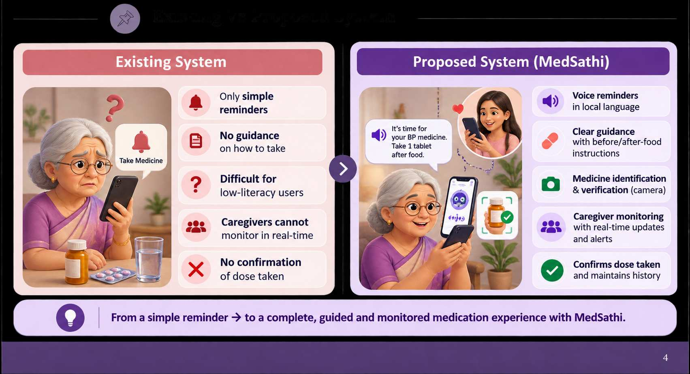
Existing Vs Proposed System
4

Slide 4
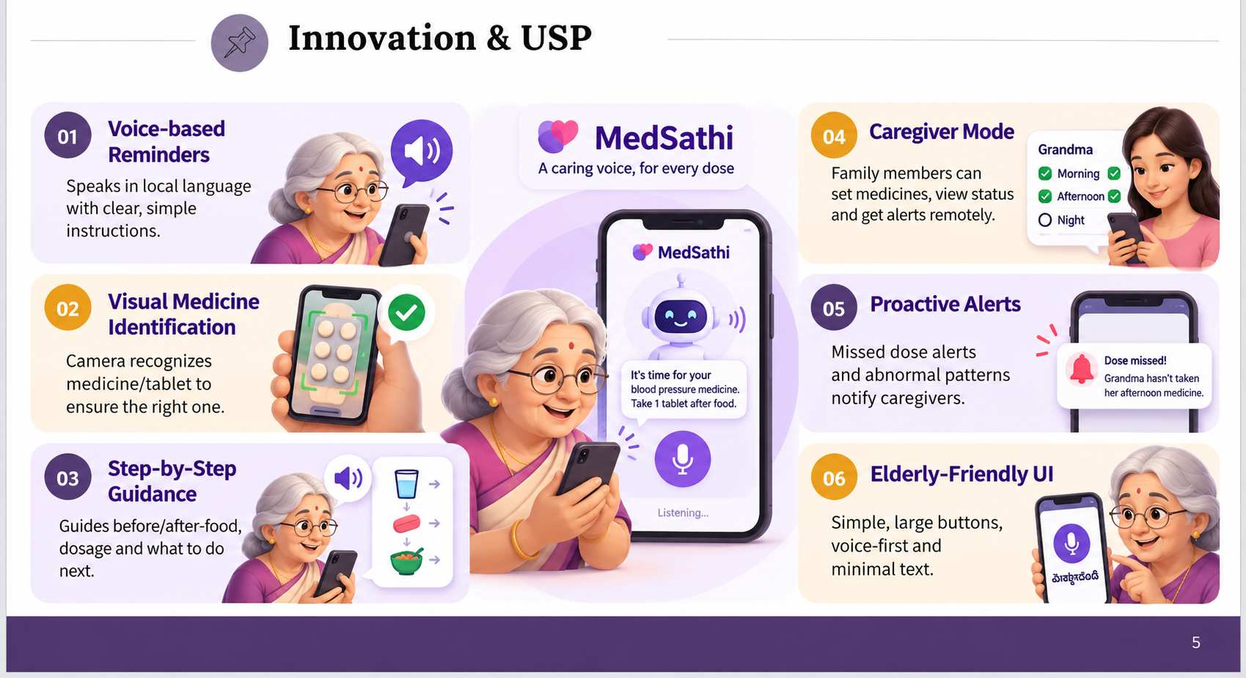
Innovation & USP
  Highlight the unique and innovative aspects of the proposed solution.
5

Slide 5
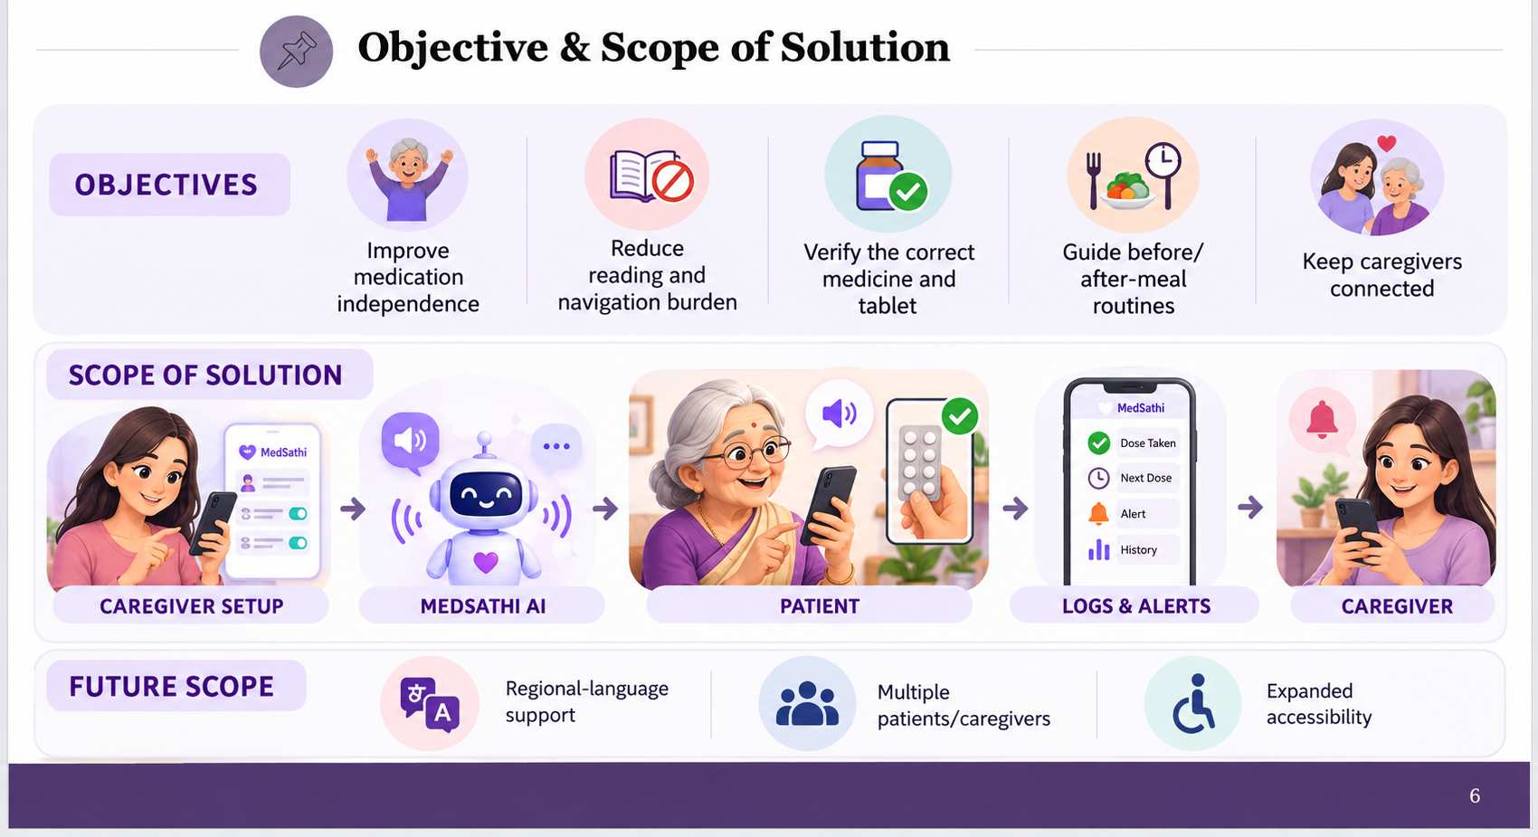
Objective & Scope of Solution
6

Slide 6
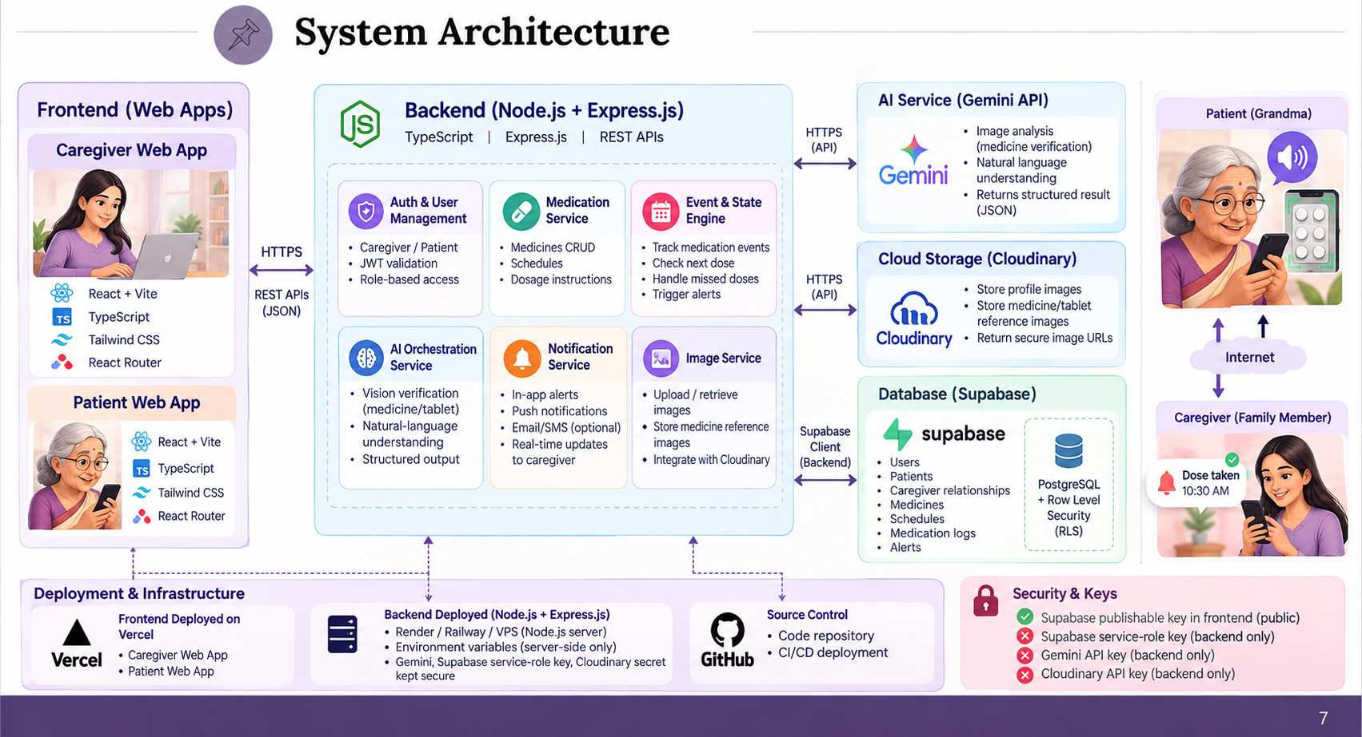
System Architecture
  Illustrate the high-level architecture and workflow of the solution.
7

Slide 7
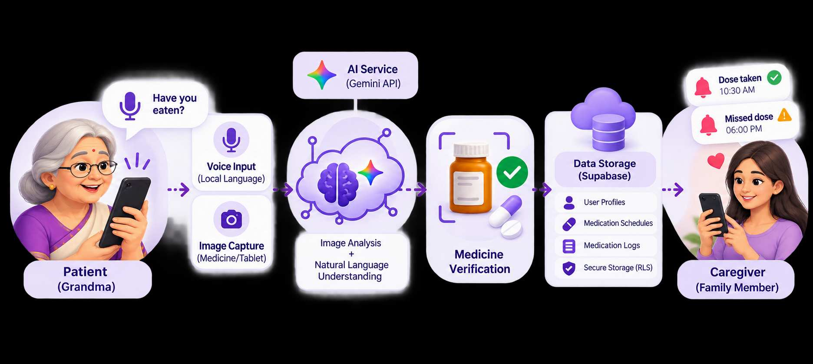
⌖
Resources Required
</>
AI
◉
☁
TECHNOLOGY
DATA & AI
HARDWARE
DEPLOYMENT
React + Vite + TypeScript
Node.js + Express.js
Supabase • Gemini • Cloudinary
Medicine reference images
Medication schedules & logs
Voice + AI vision / NLU
Smartphone / Tablet
Camera • Microphone • Speaker
Internet connectivity
GitHub version control
Vercel + backend server
Secure API credentials
CONFIGURE → UNDERSTAND → VERIFY → LOG → NOTIFY
Built for accessible, secure and caregiver-connected medication support.
8

Slide 8
